Slide 1
Cloud Computing Issues and Challenges
Y30180733张知行 Y30180732张佳影

Slide 2
Outline
Introduction
CLOUD, SOC, AND GRID
CHALLENGES
ISSUE
Notes:
介绍、云计算和其他相似概念的关系、挑战和问题

Slide 3
Cloud Computing
Cloud computing is a model for enabling convenient, on- demand network access to a shared pool of configurable computing resources (e.g., networks, servers, storage, applications, and services) that can be rapidly provisioned and released with minimal management effort or service provider interaction
Notes:
美国国家标准与技术研究院

Slide 4
Cloud Computing
Cloud computing is a model for enabling convenient, on-demand network access to a shared pool of configurable computing resources (e.g., networks, servers, storage, applications, and services) that can be rapidly provisioned and released with minimal management effort or service provider interaction
On-demand self-service
1
Broad network access
2
Resource pooling
3
Rapid elasticity
4
Measured Service
5
Notes:
这句话 5个元素
以云服务作为例子

Slide 5

On-demand self-service
A consumer with an instantaneous need at a particular timeslot can avail computing resources (such as CPU time, network storage, software use, and so forth) in an automatic fashion without resorting to human interactions with providers of these resources.
Notes:
按需，自助
即时的需求，不需要和别人交互

Slide 6

Broad network access
Computing resources are delivered over the network
used by various client applications
with heterogeneous platforms (such as mobile phones, laptops, and PDAs)
situated at a consumer's site.
Notes:
网络分发
不同的客户端应用
应用运行在各种各样的平台
应用还在客户端

Slide 7

Resource pooling
A cloud service provider’s computing resources are 'pooled' together
Multi-tenancy or the virtualization model
Economies of scale and specialization.
‘Invisible’ to consumers
Notes:
资源池化， 聚集
多个客户端、虚拟模型
规模经济、个性化服务
客户看不到

Slide 8

Rapid elasticity
For consumers, computing resources become immediate rather than persistent
Moreover, resources provisioning appears to be infinite to them, the consumption can rapidly rise in order to meet peak requirement at any time.
Notes:
快速的，弹性的
时间（立即的 不是持久的）
、空间 （峰值）

Slide 9

Measured Service
the cloud infrastructure is able to use appropriate mechanisms to measure the usage of these resources for each individual consumer through its metering capabilities.
Notes:
可测量性
各种都要测量

Slide 10
Service Model
In addition to these five essential characteristics, the cloud community has extensively used the following four service models to categories the cloud services:
Software as a Service (SaaS)
1
Platform as a Service (PaaS)
2
Infrastructure as a Service (IaaS)
3
Data storage as a Service (DaaS)
4

Slide 11



Software as a Service (SaaS)
Cloud consumers release their applications on a hosting environment
Can be accessed through networks from various clients (e.g. web browser, PDA, etc.) by application users.
Different cloud consumers' applications are organized in a single logical

Slide 12


Platform as a Service (PaaS)
A development platform supporting the full "Software Lifecycle"
SaaS only hosts completed cloud applications whereas PaaS offers a development platform that hosts both completed and in-progress cloud applications.
Notes:
软件生命周期
区别：支持还在开发的软件

Slide 13




Infrastructure as a Service (IaaS)
Directly use IT infrastructures provided in the IaaS cloud.
processing, storage, networks, and other fundamental computing resources
Meet growing or shrinking resource demand from cloud consumers

Slide 14

Data storage as a Service (DaaS)
The delivery of virtualized storage on demand becomes a separate Cloud service - data storage service.
DaaS could be seen as a special type IaaS.
DaaS allows consumers to pay for what they are actually using rather than the site license for the entire database.

Slide 15
Deployment Model
More recently, four cloud deployment models have been defined in the Cloud community:
Private cloud
1
Community cloud
2
Public cloud
3
Hybrid cloud
4
Notes:
部署模型，设备归属
分别举例

Slide 16

Private cloud
The cloud infrastructure is operated solely within a single organization
The motivation
To maximize and optimize the utilization of existing in-house resources.
Security concerns including data privacy and trust also make Private Cloud an option for many firms.
Data transfer cost from local IT infrastructure to a Public Cloud is still rather considerable.
Organizations always require full control over mission-critical activities that reside behind their firewalls.
Last, academics often build private cloud for research and teaching purposes.
Notes:
实验室内部云，所有设备都是实验室买的，内部使用

Slide 17

Community cloud
Several organizations jointly construct and share the same cloud infrastructure
The cloud infrastructure could be hosted by a third-party vendor or within one of the organizations in the community.
Notes:
多个组织共用一个云设备
这个设备可以第三方，也可以。。
几个实验室共用

Slide 18

Public cloud
The public cloud is used by the general public
Cloud consumers and the cloud service provider has the full ownership of the public cloud
Notes:
学校提供设备，校园网、mail点ecust 都属于

Slide 19
Hybrid cloud
The cloud infrastructure is a combination of two or more
Margining out peripheral business functions onto the cloud while controlling core activities on-premise through private cloud.
Hybrid cloud has raised the issues of standardization and cloud interoperability that will be discussed in later sections.
Notes:
每个实验室，有自己的服务器，放着重要数据
有合用服务器，跑gpu代码，也用学校资源，邮箱，没必要自己搭建邮箱服务
问题：标准化、互操作性

Slide 20
a new type of deployment model - Virtual Private Cloud (VPC)
Public
still uses computing resources pooled
A bridge
between an organization’s existing IT infrastructure and the public cloud
Virtually private
the connection through VPN
dedicate a set of 'isolated' resources to the VPC
pay-per-use
Notes:
虚拟个人云：亚马逊提出: 无缝链接

Slide 21
Outline
Introduction
CLOUD, SOC, AND GRID
CHALLENGES
ISSUE

Slide 22
CLOUD, SOC, AND GRID
Cloud and Service-Oriented Computing
Cloud and Grid Computing
Cloud and High Performance Computing
Notes:
面向服务计算
网格计算
高性能计算

Slide 23
Cloud and Service-Oriented Computing
Advances in SOC
benefit Cloud Computing
Service Description for Cloud Services
Service Discovery for Cloud Services
Service Composition for Cloud Service
Service Management for Cloud Service
Cloud computing benefit Service Oriented Computing
Cloud for Web Service Development
Cloud for Web Service Testing
Cloud for Web Service Deployment
Cloud for Service Process Enactment

Slide 24
Advances in SOC
Service Description for Cloud Services.
Web Services Description Language (WSDL) and the REST protocol ：two widely used interface languages to describe Web services.
Service Discovery for Cloud Services
Service Composition for Cloud Service
Service Management for Cloud Service
They have been utilized to describe Cloud API specification.
Notes:
服务接口语言，应用于云服务接口

Slide 25
Advances in SOC
Service Description for Cloud Services.
Service Discovery for Cloud Services
Service Composition for Cloud Service
Service Management for Cloud Service
Various service discovery models can be leveraged for cloud resource discovery, selection and service-level agreement verification.
Notes:
服务探索模型可以被应用到云服务

Slide 26
Advances in SOC
Service Description for Cloud Services.
Service Discovery for Cloud Services
Service Composition for Cloud Service
Service Management for Cloud Service
Since Web services are born to compose business applications, a great deal of research in this area can be leveraged for cloud services integration, collaboration, composition.
Notes:
网络服务有许许多多的研究，在云服务构建的过程中都能有所运用

Slide 27
Advances in SOC
Service Description for Cloud Services.
Service Discovery for Cloud Services
Service Composition for Cloud Service
Service Management for Cloud Service
Research and practices in SOA governance and services management can be adapted and reused in the cloud infrastructure management.
Notes:
最后是服务的管理，能直接运用于云服务的管理

Slide 28

Cloud computing benefit Service Oriented Computing
Cloud for Web Service Development
  Cloud can host service-oriented development under the PaaS service deploy model.
  SOC development often requires distributed computing resources that are difficult to obtain for SMEs
Notes:
云计算在网页服务开发的作用：网页服务开发，能放在云上
在线编辑App, VS、Google AppEngine

Slide 29
Cloud computing benefit Service Oriented Computing
Cloud for Web Service Testing
  Web services developers could tap into infinite computing resources in a Public Cloud to simulate real-world automated machine requests and network flows as a means of load testing and stress testing for services.
  The low cost and accessibility of the Cloud’s extremely large computing
Notes:
除了开发：，测试也要
模拟请求、模拟流量
云有大量计算资源、便宜

Slide 30

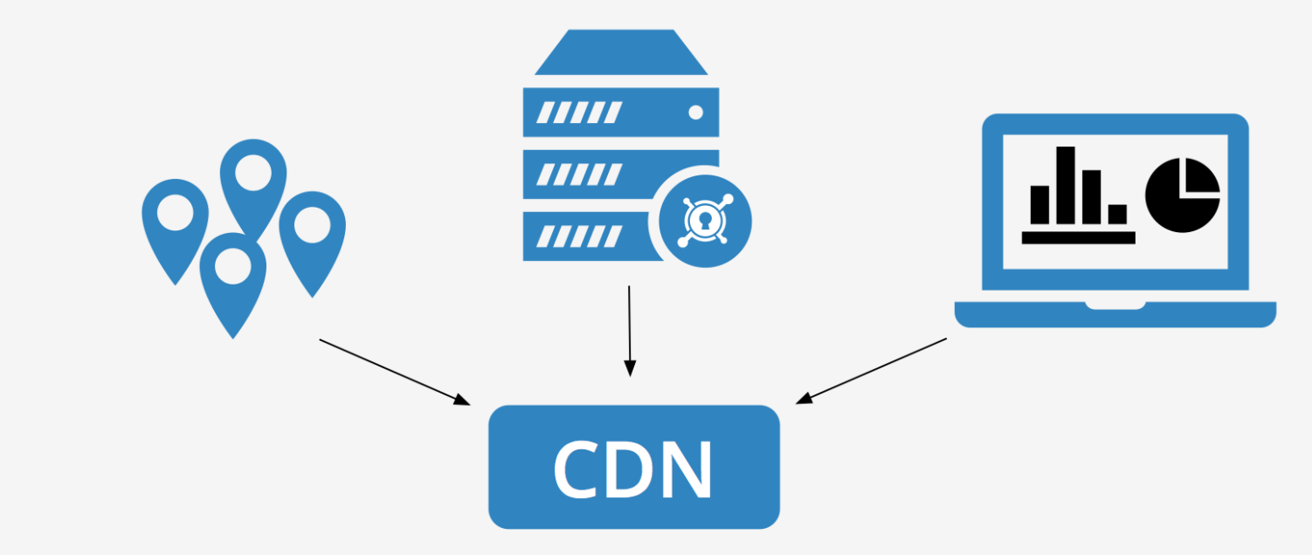
Cloud computing benefit Service Oriented Computing
Cloud for Web Service Deployment
  When requests are present, a service deployment image will be loaded into a specified virtual machine to serve the client requests.
Notes:
部署

Slide 31

Cloud computing benefit Service Oriented Computing
Cloud for Service Process Enactment
  The integration and composition of services become frequent problems
  Re-use of solutions that are ready-to-use with minor configuration and composition patterns using various algorithms (e.g. Case-Based Reasoning).
Notes:
不同的服务集成打包很麻烦，又很频繁
云服务器，大礼包形式，创建需要的镜像

Slide 32
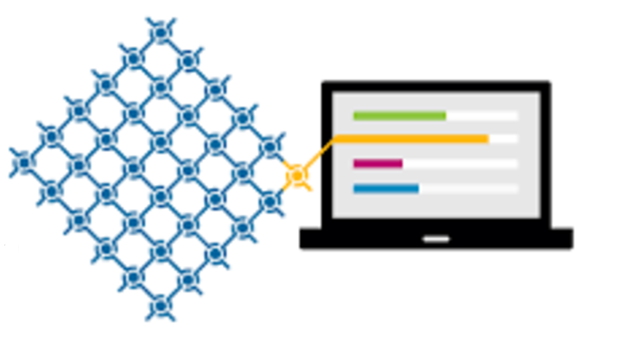
Cloud and Grid Computing
Grid computing is a hardware and software infrastructure motivated by real problems appearing in advanced scientific research. There exists evident similarities between Cloud Computing and Grid Computing.
Similarity
aim to achieve resource virtualization

Slide 33
Cloud and Grid Computing-Differences
Grid ：the “resource sharing”
Cloud ：allocates resources to different running instances
Grid ： maximum computing capacity for a huge task through resource sharing.
Cloud ：small-to-medium tasks
Grid ： re-usability for (scientific) high performance computing. Cloud ：computing is directly pulled by immediate user needs
Grid：achieve maximum computing.
Cloud：optimizing the overall computing capacity.
Notes:
网格：资源共享的计算，云计算：所有的资源都被分配到不同的实例
网格：为巨大的任务调度共享资源，实现资源的最大化，云：中小型任务
网格：尽可能最大化计算，云：优化全局计算资源
网格：资源都是复用的，共享的，云：根据用户需求，时时的

Slide 34

Cloud and High Performance Computing
High-performance computing (HPC) ：
solve advanced (scientific) computation problems.
widely used for scientific tasks
parallelization
capacity is often fixed
enhance the performance of a specific scientific application
Cloud computing
highly complicated state and data dependencies
amongst many business applications
focuses on enhancing the overall system performance as a whole
self- service
Notes:
高性能计算解决高级的科学计算问题
面向科学任务
大量的并行
一般所用的资源是固定的
针对科学任务优化性能
云计算：
应用在商业领域，复杂的状态、数据依赖性
解决整体性能
自助服务的特性

Slide 35
Outline
Introduction
CLOUD, SOC, AND GRID
CHALLENGES
ISSUE

Slide 36
Challenges
Security
Costing model
Charging model
Service Level Agreement
What to migrate

Slide 37
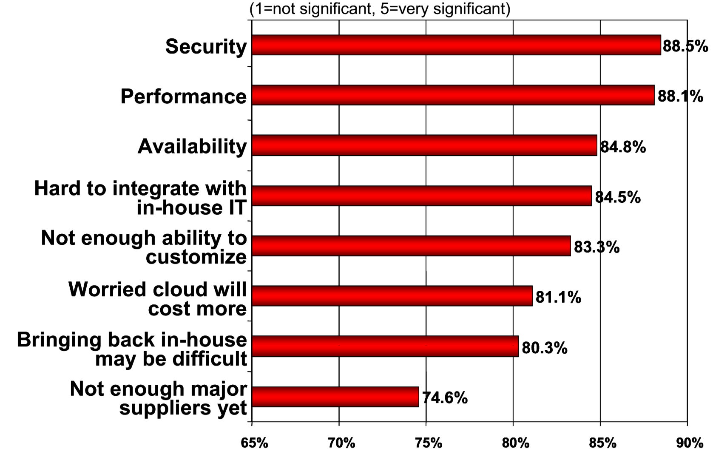
Security
putting your data, running your software at someone else's hard disk using someone else's CPU appears daunting to many.
Well-known security issues such as data loss, phishing,
the multi-tenancy , pooled computing introduced new security challenges

Slide 38
Security
Cloud often provides more reliable infrastructure services at a relatively cheaper price for hackers to start an attack.
shared resources (hard disk, data, VM) on the same physical machine invites unexpected side channels between a malicious resource and a regular resource
the issue of "reputation fate-sharing" will severely damage the reputation of many good Cloud "citizens" who happen to, unfortunately, share the computing resources with their fellow tenant - a notorious user with a criminal mind. Since they may share the same network address, any bad conduct will be attributed to all the users without differentiating real subverters from normal users.
Notes:
例子：
云设施便宜又好用，那么机器人，成本
共享物理资源，侧信道
名声问题：因为资源的共享，这里典型的是ip地址共享，如果共享ip的那个人。。。

Slide 39
Costing Model
The tradeoffs amongst computation, communication, and integration.
The cost of transferring an organization's data to and from the public and community Cloud
"Put the computation near the data“
by Gray
different clouds often use proprietary protocols and interfaces
Notes:
必须在计算、通讯、集成之间权衡
虽然云计算节省了计算成本，但是在之前提到的混合云、社区云中，数据的迁移会提高成本

Slide 40
Charging Model
the elastic resource pool has made the cost analysis a lot more complicated
unit of cost analysis：instantiated virtual machine
software licenses, virtual network usage, node and hypervisor management overhead, and so on.
a strategic and viable charging model for SaaS provider is crucial
Notes:
收费模式
资源池的使用，导致了成本分析的复杂性
在云计算中，最小单元是实例化了的虚拟机，而不是更下层的物理资源
当然，计算的内容还包括，软件授权，虚拟网络，高级的管理

Slide 41
Service Level Agreement
It is vital for consumers to obtain guarantees from providers on service delivery.
Service Level Agreements (SLAs) negotiated between the providers and consumers
tradeoffs between expressiveness and complicatedness
Carried out in a nearly automatic fashion due to the promise of "self-service" in the cloud computing.
Notes:
服务层面的协议
先解释一下：在使用前，或者 缴费前，一般都会填写（已阅，我同意那个勾）
这个是服务的保证，
需要权衡，表达能力，和复杂度
尽可能自动化的推出，基于云服务的自助性

Slide 42
What to migrate
Notes:
云计算的构成中，更多的是软件服务而不是基础的设施服务，因为核心信息还是不方便、不敢放在云服务

Slide 43
Outline
Introduction
CLOUD, SOC, AND GRID
CHALLENGES
ISSUE

Slide 44

Cloud interoperability issue
Each cloud offering has its own way on how cloud clients/applications/users interact with the cloud.
Interoperability is essential for cloud computing.
  First, to optimize the IT asset and computing resources, an organization often needs to keep in-house IT assets and capabilities associated with their core competencies while outsourcing marginal functions and activities
  Second, more often than not, for the purpose of optimization, an organization may need to outsource a number of marginal functions to cloud services offered by different vendors.
Notes:
互操作性问题的产生：每个云有自己的协议、运行方式，定义怎么和用户交互
然而在实际应用场景下，核心数据放在内部，边缘功能放在云端非常常见
实验室内部代码，又要调用学校提供的服务

Slide 45
Issue
Intermediary Layer
Standard
Open API
SaaS Interoperability

Slide 46
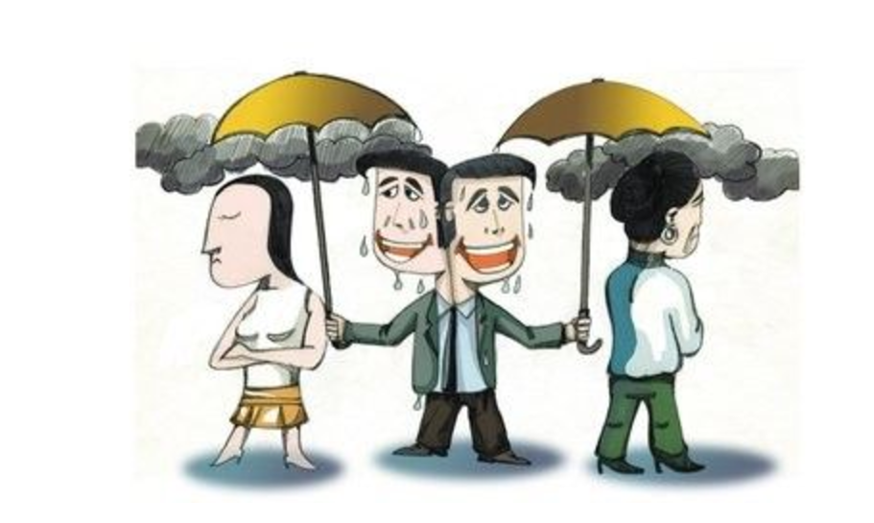
Intermediary Layer
A number of recent works address the interoperability issue by providing an intermediary layer between the cloud consumers and the cloud-specific resources (e.g. VM).
Notes:
一个方法是应用中间层，中间层负责处理好不同云服务的细节，为上层提供统一的接口

Slide 47
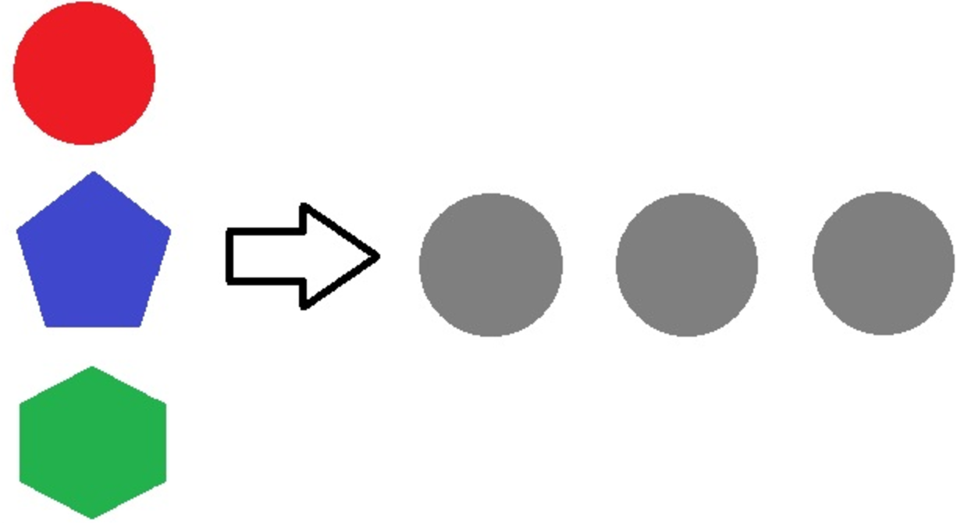
Standard
Standardization appears to be a good solution to address the interoperability issue.
However, as cloud computing just starts to take off, the interoperability problem has not appeared on the pressing agenda of major industry cloud vendors.
For example, neither Microsoft nor Amazon supports the Unified Cloud Interface (UCI) Project proposed by the Cloud Computing Interoperability Forum (CCIF) .
Notes:
一个很好的解决方法就是标准化
但这个过程比较难实行，因为制定标准容易，实施起来难
例如微软和亚马逊始终不愿意使用同一云接口

Slide 48


Open API
SUN has recently launched the Sun Open Cloud Platform under the Creative Commons license. A major contribution of this platform is the proposed (in-progress) the cloud API. It defines a set of clear and easy-to-understand RESTful Web services interfaces, through which cloud consumers are able to create and manage cloud resources, including compute, storage, and networking components in a unified way.
Using the HTTP as the application protocol and JSON for resource representation, the open cloud API defines the following key resource types: Cloud, Virtual Data Center, Cluster, Virtual Machine, Private Virtual Network, Public Address, Storage Volume, and Volume Snapshot. These constructs share a certain degree of similarity with the internal architectural design of Eucalyptus.

Slide 49
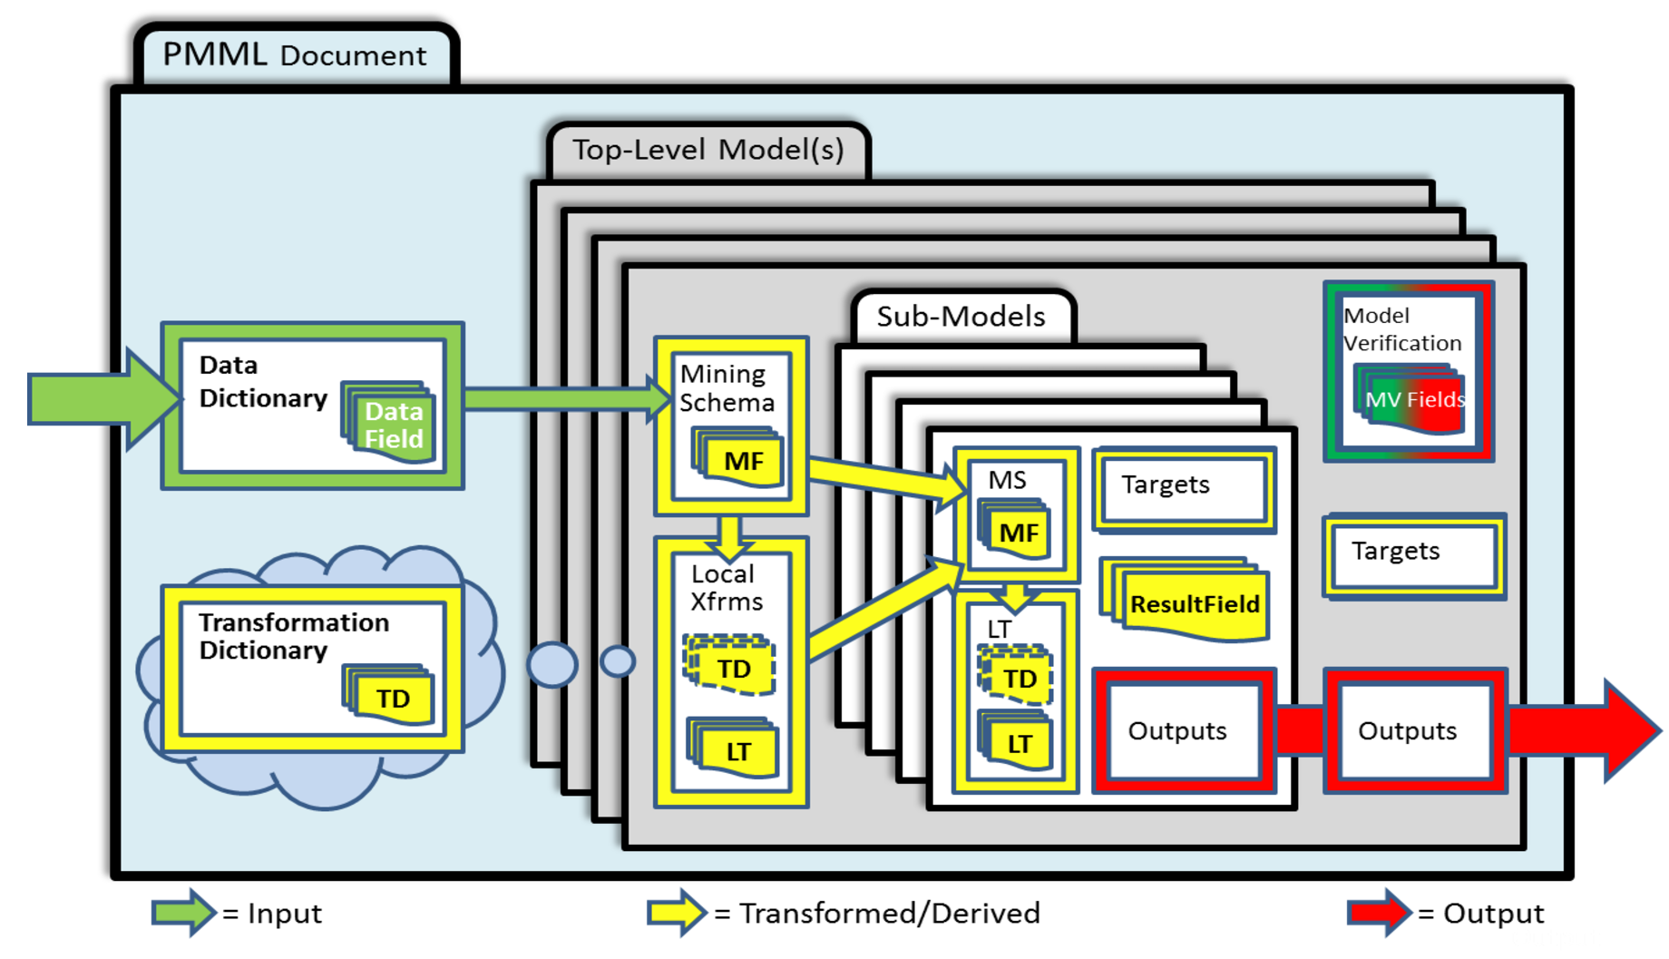
SaaS Interoperability
Predictive Model Markup Language (PMML), a gradually accepted standard that allows users to exchange predictive models among various software tools.
Notes:
之前的解决方案主要针对设备服务和数据服务，那么对于软件服务该如何解决
对于相似的任务也能利用标准来统一。比如对于数据挖掘领域，有PMML标准，来跨系统、跨工具来交互

Slide 50

Thank you
Q&A

